Slide 1

Detection of obstructive sleep apnea Disease
Presentation By
Akiti Sri Kalyan Reddy

Slide 2
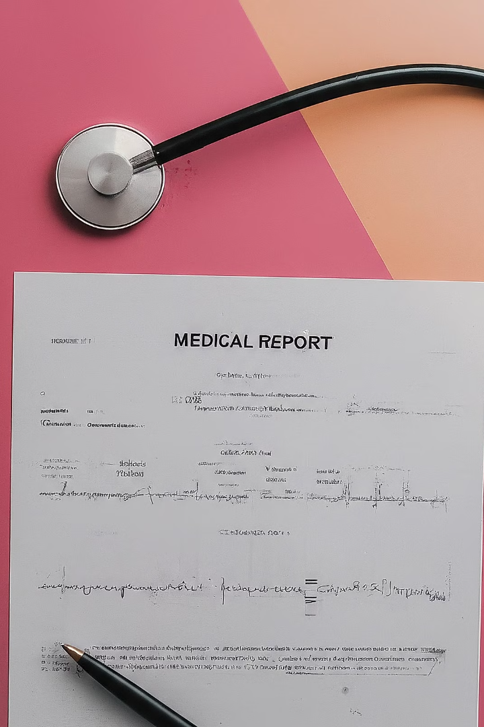
Predicting Sleep Apnea Severity from EEG Signals
Sleep apnea (OSA) is a condition where a person's airway gets blocked or partially blocked during sleep, leading to breathing pauses and lower oxygen levels. This disrupts sleep and can cause problems like loud snoring and feeling excessively tired during the day.
This project aims to use a combination of brain and body measurements to predict whether someone has OSAS. We'll use machine learning, which is a type of computer program that learns from data, to analyze a dataset containing information about how people think and their body functions.

Slide 3
Motivation
By accurately diagnosing the severity of sleep apnea, we can contribute to improving the quality of healthcare. Sleep apnea is a serious condition that can lead to various health issues if left untreated. Therefore, developing effective tools for its diagnosis and management is crucial for overall public health.

Slide 4
Exploring the Sleep Apnea Dataset
1
Dataset Description
2
Target Variable
3
Data Preprocessing
The neuro cognitive data comprises of EEG signal features like Amplitude, Delta, Theta, Alpha and Beta Values. The physiologic data comprises heart rate, skin conductance, skin temperature, cortisol level, Systolic BP and Diastolic BP
The key variable of interest is "apnea_Severity", which categorizes the level of sleep apnea for each patient on a scale from mild to severe. This will be our target variable for the predictive model.
Before building the model, we will need to handle missing data, map categorical variables to numeric values, and select the most relevant features from the dataset. This data preparation step is crucial for ensuring the model's accuracy and performance.

Slide 5
Scaling and Normalizing the Data
Data Scaling
Importance of Normalization
Techniques Explored
To ensure that all the input features are on a similar scale, we will apply data scaling techniques, such as standardization or normalization. This step helps prevent certain features from dominating the model's learning process and improves the overall performance.
We will experiment with different scaling methods, such as min-max scaling and z-score normalization, to determine the most suitable approach for this dataset and the specific problem of sleep apnea severity prediction.
Normalization is particularly important when working with physiological signals, as the ranges and units of these measurements can vary greatly. By bringing all the features to a common scale, we can enhance the model's ability to identify patterns and relationships in the data.

Slide 6
Designing the Predictive Model
1
Model Architecture
The core of our predictive system is a deep neural network, which is well-suited for learning complex patterns from the diverse set of physiological signals in the dataset. The network will have multiple hidden layers, each with its own set of neurons and connections, to capture the intricate relationships between the input features and the target variable.
2
Feature Selection
Before training the model, we will carefully select the most informative features from the dataset. This step helps to reduce the model's complexity, improve its generalization, and enhance its predictive performance. Techniques like correlation analysis and recursive feature elimination will be employed to identify the most relevant physiological signals.
3
Training Procedure
The neural network will be trained using a portion of the dataset, with the remaining data reserved for testing and model evaluation. During the training process, the model will iteratively adjust its internal parameters to minimize the error between its predictions and the true sleep apnea severity levels.

Slide 7
Evaluating Model Performance
Validation Metrics
Cross-Validation
To assess the model's performance, we will use a range of evaluation metrics, such as mean squared error (MSE), R-squared, and classification accuracy. These metrics will provide insights into the model's ability to accurately predict the severity of sleep apnea based on the input physiological signals.
To ensure the robustness of our model, we will employ cross-validation techniques, such as k-fold cross-validation. This will allow us to evaluate the model's performance on multiple subsets of the data, giving us a more reliable estimate of its generalization capability.
Hyperparameter Tuning
Interpretability
We will also explore various hyperparameter configurations for the neural network, such as the number of layers, the size of each layer, and the learning rate. By optimizing these hyperparameters, we can further improve the model's predictive accuracy and ensure it is well-suited for the task of sleep apnea severity prediction.
In addition to evaluating the model's performance, we will also investigate its interpretability. By analyzing the relative importance of different physiological signals, we can gain insights into the key factors contributing to the prediction of sleep apnea severity, which can inform future research and clinical decision-making.

Slide 8
Implications and Future Directions
Clinical Applications
Research Opportunities
Technological Advancements
The accurate prediction of sleep apnea severity can significantly enhance clinical decision-making, leading to more effective treatment plans and improved patient outcomes. Healthcare providers can use this model to streamline the diagnosis process and tailor interventions based on the predicted severity level.
This work contributes to the growing body of research on the use of machine learning in sleep disorder detection and monitoring. The insights gained from this study can inspire further investigations into the relationship between physiological signals and sleep apnea, potentially leading to the development of more sophisticated predictive models.
The development of this predictive model lays the groundwork for the integration of advanced technologies, such as wearable devices and remote monitoring systems, into the diagnosis and management of sleep apnea. Future iterations of this work can explore the use of real-time data collection and automated prediction capabilities for enhanced patient care.

Slide 9

Conclusion
In this comprehensive guide, we have outlined the process of developing a robust machine learning model to predict the severity of sleep apnea based on physiological signals. By leveraging the rich data in the "apneaset.csv" dataset, we have designed a deep neural network that can accurately assess the level of sleep apnea in patients. Through rigorous data preprocessing, feature selection, model training, and evaluation, we have created a reliable tool that can support healthcare professionals in the diagnosis and management of this prevalent sleep disorder.
The successful deployment of this predictive model in real-world scenarios holds great promise for improving patient outcomes and streamlining the clinical decision-making process. Moving forward, we will continue to refine and expand the capabilities of this system, exploring opportunities for integration with emerging technologies and fostering interdisciplinary collaborations to further advance the field of sleep apnea research and treatment.

Slide 10
THANK YOU

